Slide 1

CSE 102 - COMPUTER PROGRAMMING II Data Structures
Joseph LEDET
Department of Computer Engineering
Akdeniz University
josephledet@akdeniz.edu.tr

Slide 2
Objectives
To explore the relationship between interfaces and classes in the Java Collections Framework hierarchy (§20.2).
To use the common methods defined in the Collection interface for operating collections (§20.2).
To use the Iterator interface to traverse the elements in a collection (§20.3).
To use a for-each loop to traverse the elements in a collection (§20.3).
To explore how and when to use ArrayList or LinkedList to store elements (§20.4).
To compare elements using the Comparable interface and the Comparator interface (§20.5).
To use the static utility methods in the Collections class for sorting, searching, shuffling lists, and finding the largest and smallest element in collections (§20.6).
To develop a multiple bouncing balls application using ArrayList (§20.7).
To distinguish between Vector and ArrayList and to use the Stack class for creating stacks (§20.8).
To explore the relationships among Collection, Queue, LinkedList, and PriorityQueue and to create priority queues using the PriorityQueue class (§20.9).
To use stacks to write a program to evaluate expressions (§20.10).

Slide 3
Java Collection Framework hierarchy
A collection is a container object that holds a group of objects, often referred to as elements. The Java Collections Framework supports three types of collections, named lists, sets, and maps.
Class Container
java.lang.Object
java.awt.Component
java.awt.Container

Slide 4
public class Container
Extends Component
A generic Abstract Window Toolkit(AWT) container object is a component that can contain other AWT components.
Components added to a container are tracked in a list. The order of the list will define the components' front-to-back stacking order within the container.
If no index is specified when adding a component to a container, it will be added to the end of the list (and hence to the bottom of the stacking order).

Slide 5
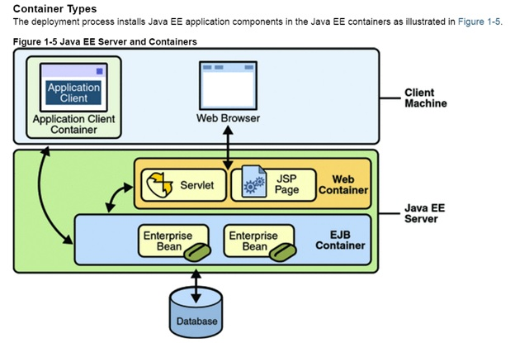
Containers
Containers are the interface between a component and the low-level platform-specific functionality that supports the component.

Slide 6
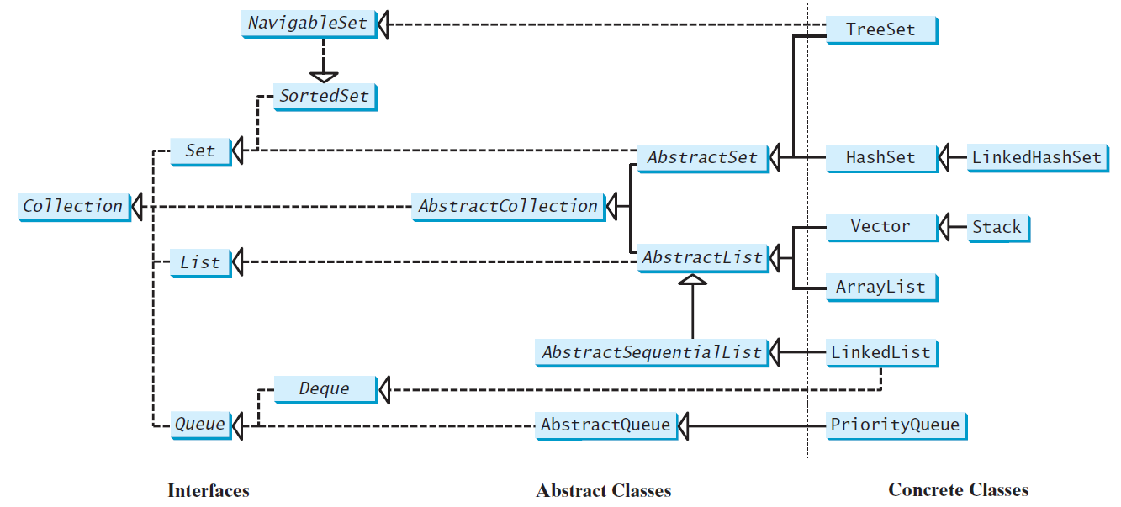
Java Collection Framework hierarchy, cont.
Set and List are subinterfaces of Collection.

Slide 7
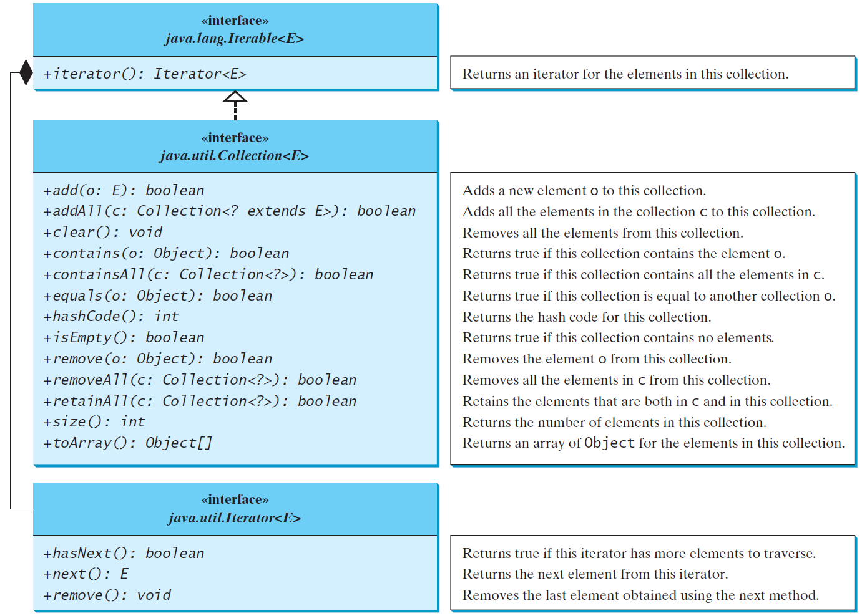
The Collection Interface
The Collection interface is the root interface for manipulating a collection of objects.

Slide 8
The List Interface
A list stores elements in a sequential order, and allows the user to specify where the element is stored. The user can access the elements by index.

Slide 9
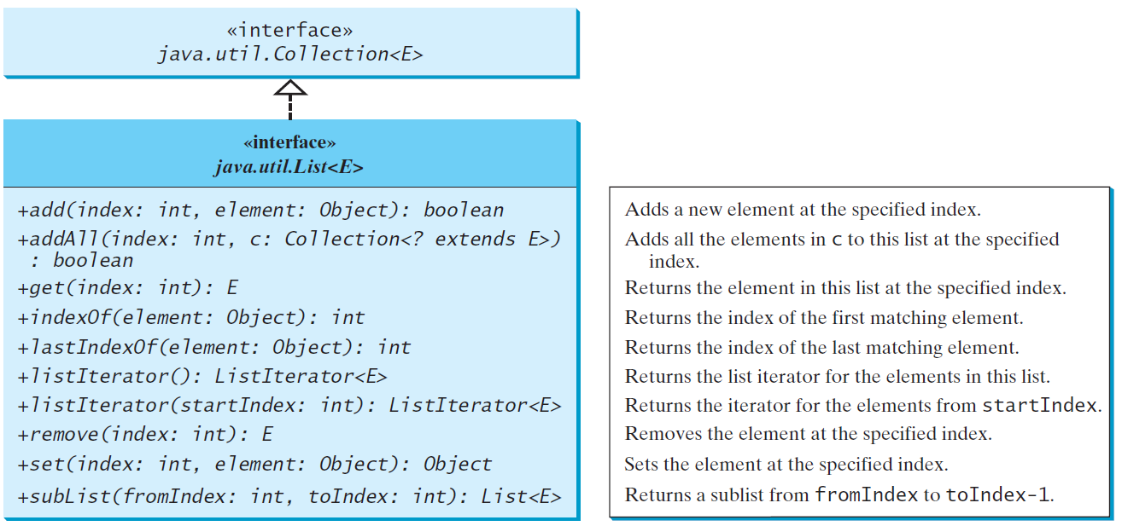
The List Interface, cont.

Slide 10
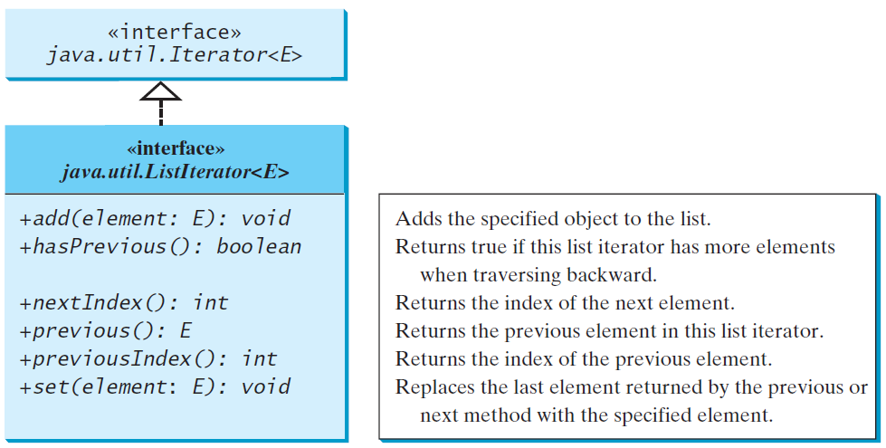
The List Iterator

Slide 11
ArrayList and LinkedList
The ArrayList class and the LinkedList class are concrete implementations of the List interface. Which of the two classes you use depends on your specific needs.
If you need to support random access through an index without inserting or removing elements from any place other than the end, ArrayList offers the most efficient collection.
If, however, your application requires the insertion or deletion of elements from any place in the list, you should choose LinkedList. A list can grow or shrink dynamically. An array is fixed once it is created. If your application does not require insertion or deletion of elements, the most efficient data structure is the array.

Slide 12
java.util.ArrayList

Slide 13
java.util.LinkedList

Slide 14
Example: Using ArrayList and LinkedList
This example creates an array list filled with numbers, and inserts new elements into the specified location in the list.
The example also creates a linked list from the array list, inserts and removes the elements from the list.
Finally, the example traverses the list forward and backward.
TestArrayAndLinkedList

Slide 15
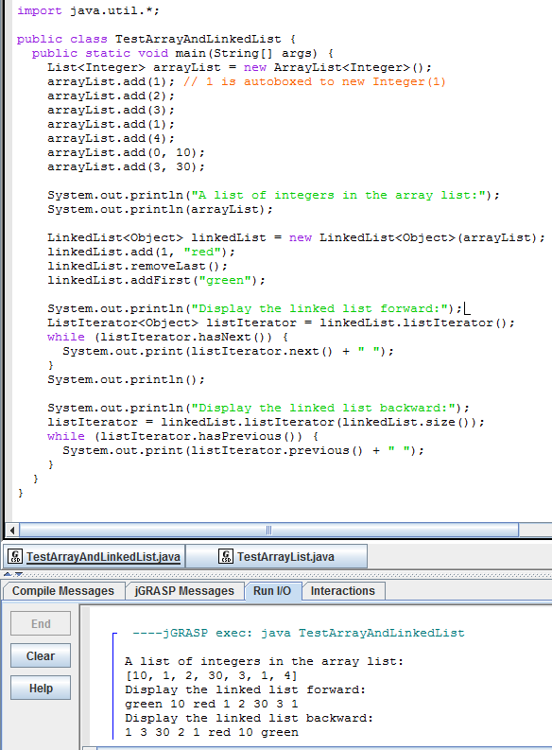
import java.util.*; public class TestArrayAndLinkedList { public static void main(String[] args) { List<Integer> arrayList = new ArrayList<Integer>(); arrayList.add(1); // 1 is autoboxed to new Integer(1) arrayList.add(2); arrayList.add(3); arrayList.add(1); arrayList.add(4); arrayList.add(0, 10); arrayList.add(3, 30); System.out.println("A list of integers in the array list:"); System.out.println(arrayList); LinkedList<Object> linkedList = new LinkedList<Object>(arrayList); linkedList.add(1, "red"); linkedList.removeLast(); linkedList.addFirst("green"); System.out.println("Display the linked list forward:"); ListIterator<Object> listIterator = linkedList.listIterator(); while (listIterator.hasNext()) { System.out.print(listIterator.next() + " "); } System.out.println(); System.out.println("Display the linked list backward:"); listIterator = linkedList.listIterator(linkedList.size()); while (listIterator.hasPrevious()) { System.out.print(listIterator.previous() + " "); } } }

Slide 16
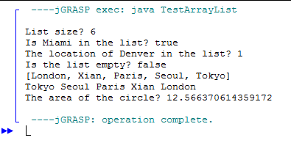
public class TestArrayList { public static void main(String[] args) { // Create a list to store cities java.util.ArrayList cityList = new java.util.ArrayList(); // Add some cities in the list cityList.add("London"); // cityList now contains [London] cityList.add("Denver"); // cityList now contains [London, Denver] cityList.add("Paris"); // cityList now contains [London, Denver, Paris] cityList.add("Miami"); // cityList now contains [London, Denver, Paris, Miami] cityList.add("Seoul"); // contains [London, Denver, Paris, Miami, Seoul] cityList.add("Tokyo"); // contains [London, Denver, Paris, Miami, Seoul, Tokyo] System.out.println("List size? " + cityList.size()); System.out.println("Is Miami in the list? " + cityList.contains("Miami")); System.out.println("The location of Denver in the list? " + cityList.indexOf("Denver")); System.out.println("Is the list empty? " + cityList.isEmpty()); // Print false // Insert a new city at index 2 cityList.add(2, "Xian"); // contains [London, Denver, Xian, Paris, Miami, Seoul, Tokyo] // Remove a city from the list cityList.remove("Miami"); // contains [London, Denver, Xian, Paris, Seoul, Tokyo]
// Remove a city at index 1 cityList.remove(1); // contains [London, Xian, Paris, Seoul, Tokyo] // Display the contents in the list System.out.println(cityList.toString()); // Display the contents in the list in reverse order for (int i = cityList.size() - 1; i >= 0; i--) System.out.print(cityList.get(i) + " "); System.out.println(); // Create a list to store two circles java.util.ArrayList list = new java.util.ArrayList(); // Add two circles list.add(new Circle4(2)); list.add(new Circle4(3)); // Display the area of the first circle in the list System.out.println("The area of the circle? " + ((Circle4)list.get(0)).getArea()); } }

Slide 17
The Comparator Interface
Sometimes you want to compare the elements of different types.
The elements may not be instances of Comparable or are not comparable.
You can define a comparator to compare these elements. To do so, define a class that implements the java.util.Comparator interface.
The Comparator interface has two methods, compare and equals.

Slide 18
The Comparator Interface
public int compare(Object element1, Object element2)
Returns a negative value if element1 is less than element2, a positive value if element1 is greater than element2, and zero if they are equal.
GeometricObjectComparator
Run
TestComparator

Slide 19
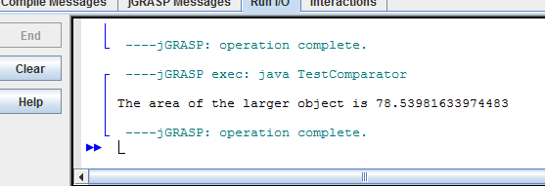
import java.util.Comparator; public class TestComparator { public static void main(String[] args) { GeometricObject g1 = new Rectangle(5, 5); GeometricObject g2 = new Circle(5); GeometricObject g = max(g1, g2, new GeometricObjectComparator()); System.out.println("The area of the larger object is " + g.getArea()); } public static GeometricObject max(GeometricObject g1, GeometricObject g2, Comparator<GeometricObject> c) { if (c.compare(g1, g2) > 0) return g1; else return g2; } }
import java.util.Comparator; public class GeometricObjectComparator implements Comparator<GeometricObject>, java.io.Serializable { public int compare(GeometricObject o1, GeometricObject o2) { double area1 = o1.getArea(); double area2 = o2.getArea(); if (area1 < area2) return -1; else if (area1 == area2) return 0; else return 1; } }

Slide 20
The Collections Class
The Collections class contains various static methods for operating on collections and maps, for creating synchronized collection classes, and for creating read-only collection classes.

Slide 21
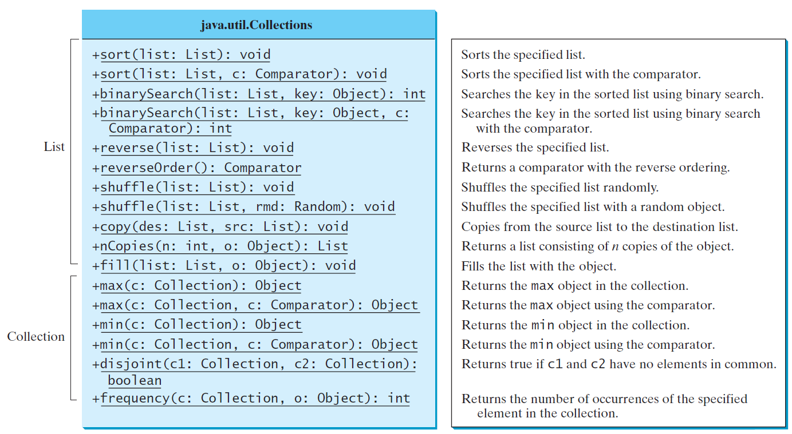
The Collections Class UML Diagram

Slide 22
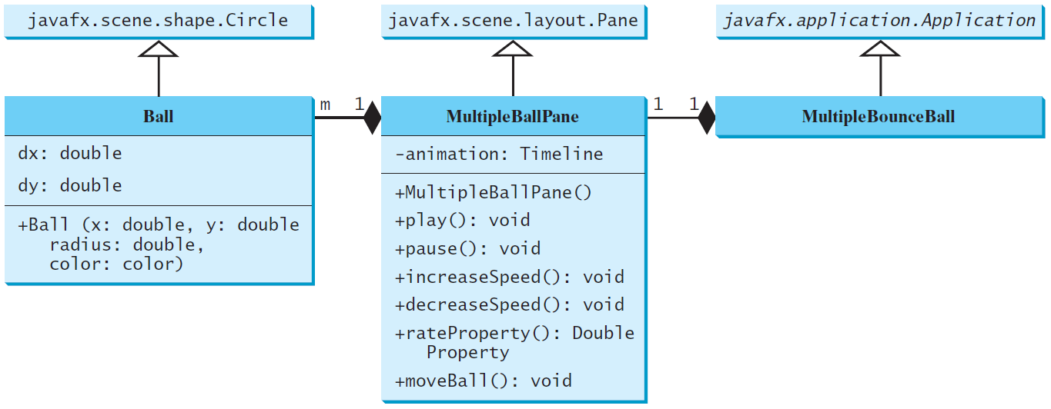
Case Study: Multiple Bouncing Balls
MultipleBounceBall
Run

Slide 23
The Vector and Stack Classes
The Java Collections Framework was introduced with Java 2. Several data structures were supported prior to Java 2. Among them are the Vector class and the Stack class. These classes were redesigned to fit into the Java Collections Framework, but their old-style methods are retained for compatibility. This section introduces the Vector class and the Stack class.

Slide 24
The Vector Class
In Java 2, Vector is the same as ArrayList, except that Vector contains the synchronized methods for accessing and modifying the vector. None of the new collection data structures introduced so far are synchronized. If synchronization is required, you can use the synchronized versions of the collection classes. These classes are introduced later in the section, “The Collections Class.”

Slide 25
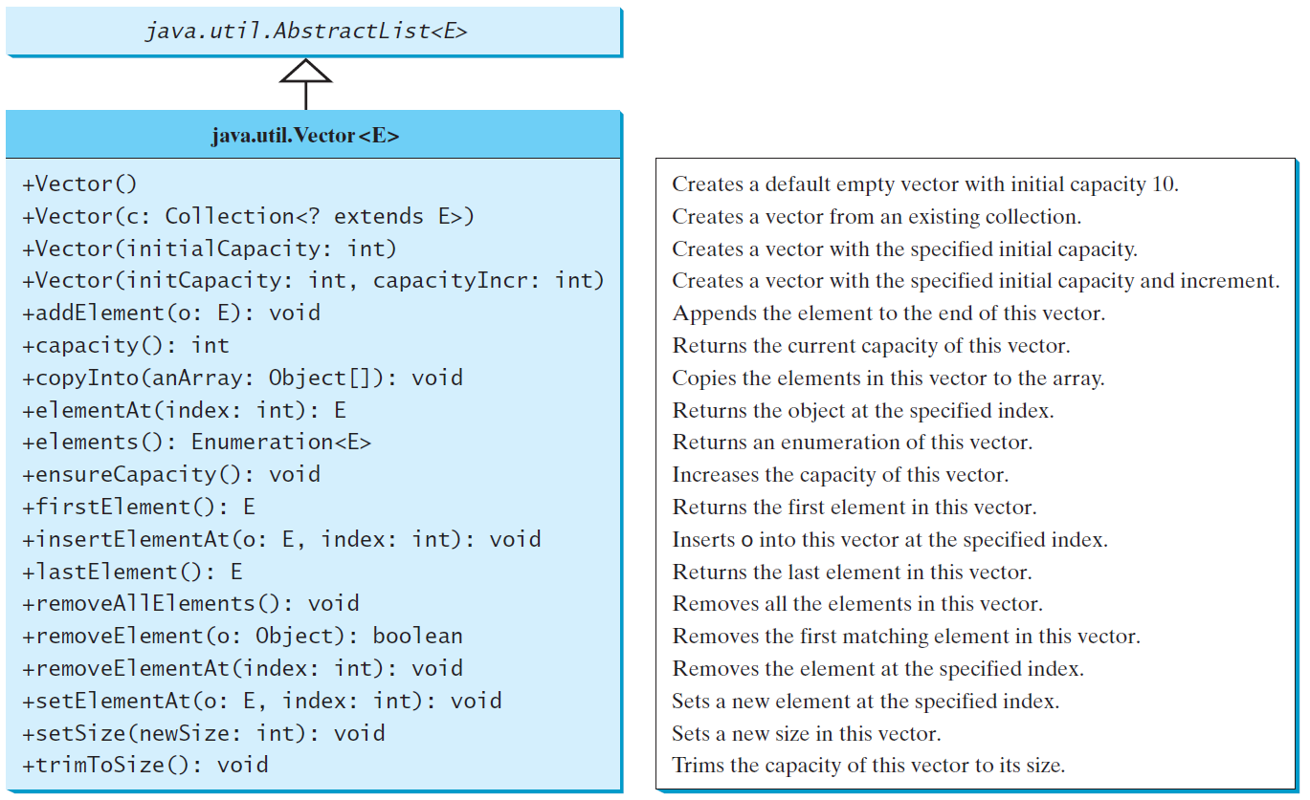
The Vector Class, cont.

Slide 26
The Stack Class
The Stack class represents a last-in-first-out (LIFO)stack of objects.
The elements are accessed only from the top of the stack. You can retrieve, insert, or remove an element from the top of the stack.

Slide 27
Queues and Priority Queues
A queue is a first-in/first-out data structure. Elements are appended to the end of the queue and are removed from the beginning of the queue. In a priority queue, elements are assigned priorities. When accessing elements, the element with the highest priority is removed first.

Slide 28
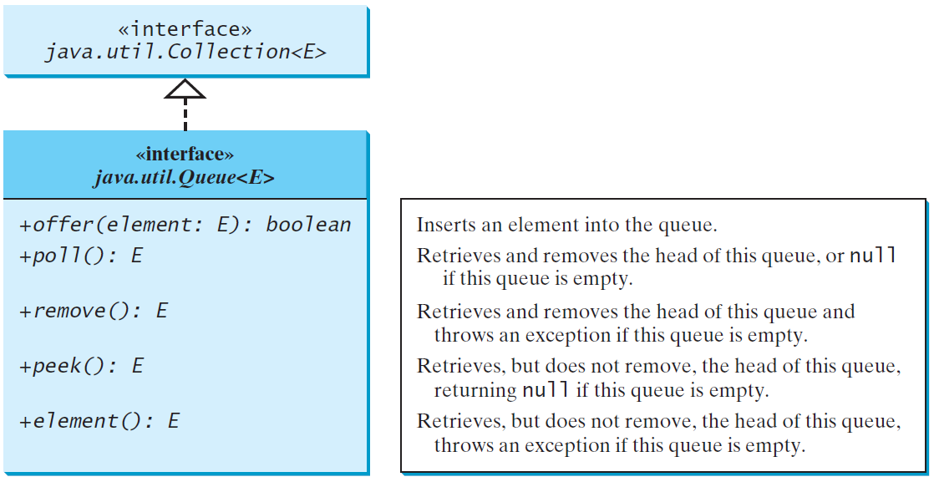
The Queue Interface

Slide 29
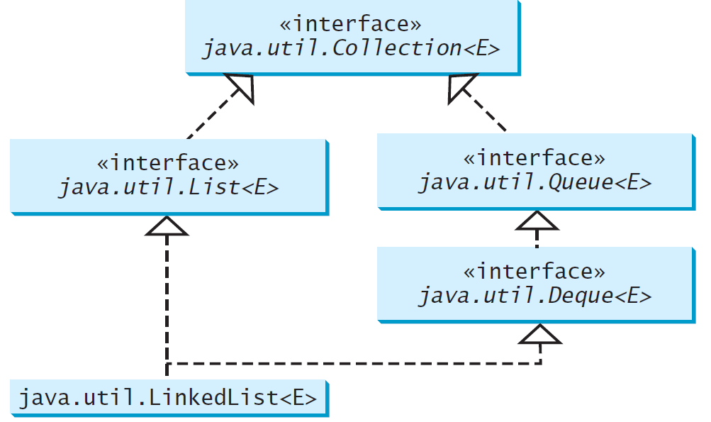
Using LinkedList for Queue

Slide 30
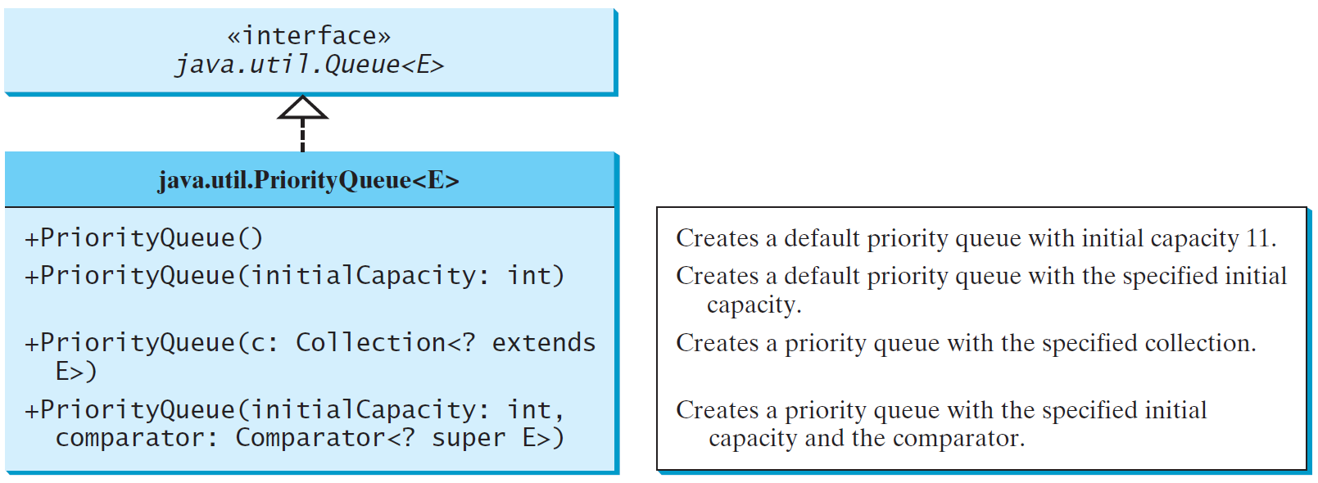
The PriorityQueue Class
PriorityQueueDemo
Run

Slide 31
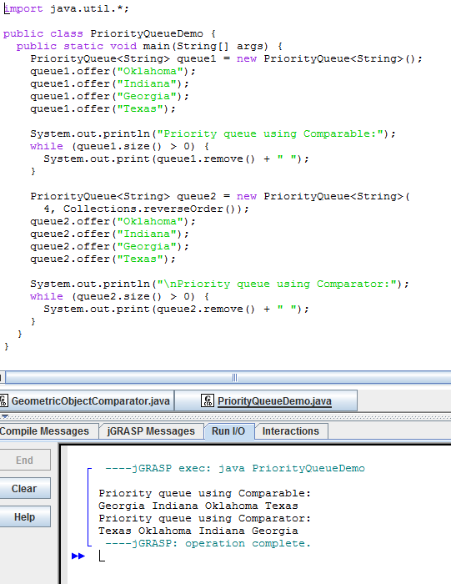
import java.util.*; public class PriorityQueueDemo { public static void main(String[] args) { PriorityQueue<String> queue1 = new PriorityQueue<String>(); queue1.offer("Oklahoma"); queue1.offer("Indiana"); queue1.offer("Georgia"); queue1.offer("Texas"); System.out.println("Priority queue using Comparable:"); while (queue1.size() > 0) { System.out.print(queue1.remove() + " "); } PriorityQueue<String> queue2 = new PriorityQueue<String>( 4, Collections.reverseOrder()); queue2.offer("Oklahoma"); queue2.offer("Indiana"); queue2.offer("Georgia"); queue2.offer("Texas"); System.out.println("\nPriority queue using Comparator:"); while (queue2.size() > 0) { System.out.print(queue2.remove() + " "); } } }

Slide 32
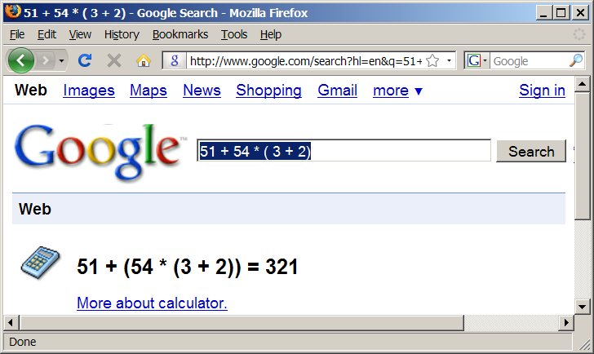
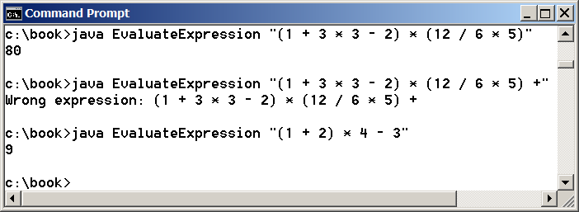
Case Study: Evaluating Expressions
Stacks can be used to evaluate expressions.
Evaluate Expression

Slide 33
Algorithm
Phase 1: Scanning the expression
The program scans the expression from left to right to extract operands, operators, and the parentheses.
1.1. If the extracted item is an operand, push it to operandStack.
1.2. If the extracted item is a + or - operator, process all the operators at the top of operatorStack and push the extracted operator to operatorStack.
1.3. If the extracted item is a * or / operator, process the * or / operators at the top of operatorStack and push the extracted operator to operatorStack.
1.4. If the extracted item is a ( symbol, push it to operatorStack.
1.5. If the extracted item is a ) symbol, repeatedly process the operators from the top of operatorStack until seeing the ( symbol on the stack.
Phase 2: Clearing the stack
Repeatedly process the operators from the top of operatorStack until operatorStack is empty.

Slide 34
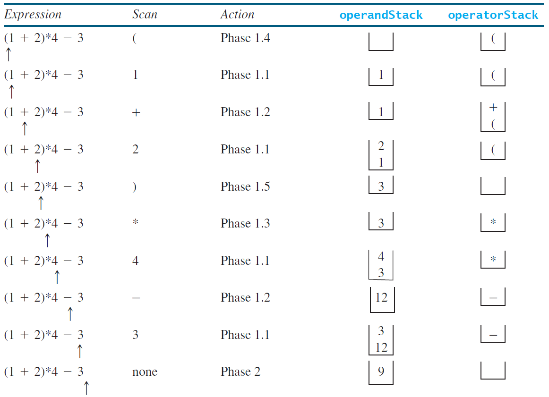
Example

